Slide 1
Threads

Slide 2
Why Threads: Balloon Shooter Game
Basic modules required
User Interface Module
Which interacts with user
Graphics Module
Which paints the screen with graphics
Action Module
Which process the action event when pressed any key by user
Score Module
Increments the score by one when hit
Decrements the score by one when misses

Slide 3
Balloon Shooter Game
Sequential Approach
int hit = 0;
int inc = 0;
int main()
{
UI();
Display();
Action();
Score();
}

Slide 4
Balloon Shooter Game
Concurrent Approach
int main()
{
UI;
createthread (Display);
createthread (Action);
createthread (Socre);
}
All modules run concurrently

Slide 5
Concurrent processes
Consider two examples having separate tasks running independently but sharing data
Difficult to write system using sequential program model
Concurrent process model easier
  Separate sequential programs (processes) for each task
  Programs communicate with each other
Heartbeat Monitoring System
B[1..4]
Heart-beat pulse
Task 1:
Read pulse
If pulse < Lo then
Activate Siren
If pulse > Hi then
Activate Siren
Sleep 1 second
Repeat
Task 2:
If B1/B2 pressed then
Lo = Lo +/– 1
If B3/B4 pressed then
Hi = Hi +/– 1
Sleep 500 ms
Repeat
Set-top Box
Task 1:
Read Signal
Separate Audio/Video
Send Audio to Task 2
Send Video to Task 3
Repeat
Task 2:
Wait on Task 1
Decode/output Audio
Repeat
Video
Audio
Input Signal
Task 3:
Wait on Task 1
Decode/output Video
Repeat
<number>

Slide 6
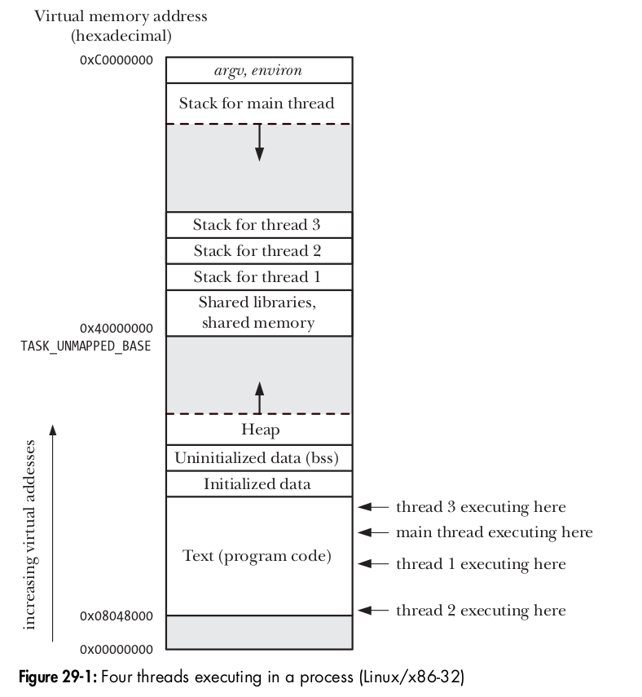
Like processes, threads are a mechanism that permits an application to perform multiple tasks concurrently. A single process can contain multiple threads, as illustrated in Figure All of these threads are independently executing the same program, and they all share the same global memory, including the initialized data, uninitialized data, and heap segments. The threads in a process can execute concurrently. On a multiprocessor system, multiple threads can execute in parallel. If one thread is blocked on I/O, other threads are still eligible to execute

Slide 7
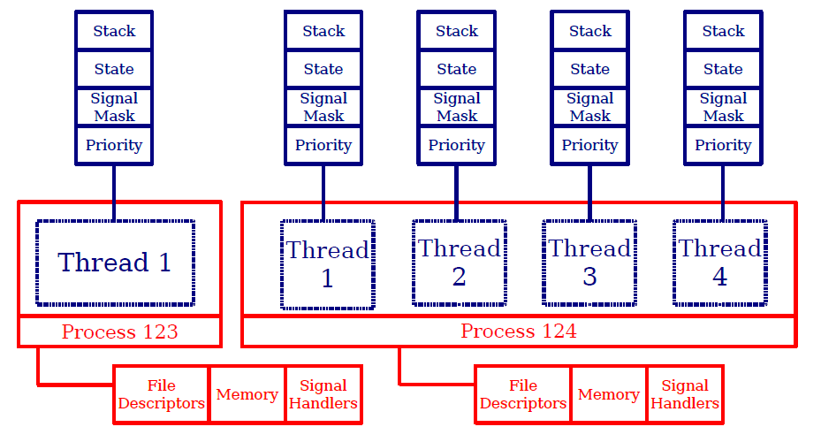
Threads
Notes:
<number>

Slide 8
Threads offer advantages over processes in certain applications. Consider the traditional UNIX approach to achieving concurrency by creating multiple processes. An example of this is a network server design in which a parent process accepts incoming connections from clients, and then uses fork() to create a separate child process to handle communication with each client. Such a design makes it possible to serve multiple clients simultaneously. While this approach works well for many scenarios, it does have the following limitations in some
applications:
-> It is difficult to share information between processes. Since the parent and child don’t share memory (other than the read-only text segment), we must use some form of interprocess communication in order to exchange information between processes.
-> Process creation with fork() is relatively expensive. Even with the copy-on-write technique, the need to duplicate various process attributes such as page tables and file descriptor tables means that a fork() call is still time-consuming.
Threads address both of these problems:
1. Sharing information between threads is easy and fast. It is just a matter of copying
data into shared (global or heap) variables
2. Thread creation is faster than process creation—typically, ten times faster or better.
Among the attributes that are distinct for each thread are the following:
1. thread ID
2. signal mask;
3. thread-specific data
4. the errno variable;
5 floating-point environment
6 realtime scheduling policy and priority
7 CPU affinity
8 stack (local variables and function call linkage information).

Slide 9
Balloon Shooter Game on windows
Data Segment
int hit = 0;
int inc = 0;
Code Segment
Main()
{ UI()
createthread (Display);
createthread (Action);
createthread (Score);
}
Code Segment
Display()
{
Body;
}
Text Segment
Action()
{
Body;
}
Text Segment
score()
{
Body;
}
Thread object
For Display
( Process Sched
entity )
Thread object
For Action
( Process Sched
entity )
Thread object
For Score
( Process Sched
entity )
User Space
Kernel Space
PCB
pid=10

Slide 10
Creating Threads
int pthread_create(pthread_t *thread,
const pthread_attr_t *attr,
void *(*start_routine)(void *),
void * arg);
The pthread_create() routine creates a new thread within a
process which executes start_routine which has a argument arg.
The new thread has attributes specified with attr, or default attributes
if attr is NULL.
If the pthread_create() on succeeds will return 0 and put the
new thread ID into thread, otherwise returns an error number
Notes:
<number>

Slide 11
Destroying Threads
void pthread_exit(void *status);
The pthread_exit() routine terminates the currently running thread
and makes status available to the thread that successfully joined
with the terminating thread.
An implicit call to pthread_exit() is made if any thread returns from
the thread routine
Notes:
<number>

Slide 12
1. When programming with threads, we need to ensure that the functions we call
are thread-safe or are called in a thread-safe manner.
2. A bug in one thread (e.g., modifying memory via an incorrect pointer) can damage all of the threads in the process, since they share the same address space and other attributes.
Besides global memory, threads also share a number of other attributes
-> process ID and parent process ID;
-> process group ID and session ID;
-> controlling terminal;
-> process credentials (user and group IDs);
-> open file descriptors;
-> record locks created using fcntl();
-> signal dispositions;
-> file system–related information: umask, current working directory, and root directory;
-> interval timers (setitimer()) and POSIX timers (timer_create());
-> System V semaphore undo (semadj) values
-> resource limits;
-> CPU time consumed (as returned by times());
-> resources consumed (as returned by getrusage()); and
-> nice value (set by setpriority() and nice()).

Slide 13
Data type Description
pthread_t
pthread_mutex_t
pthread_mutexattr_t
pthread_cond_t
pthread_condattr_t
pthread_key_t
pthread_once_t
pthread_attr_t Thread identifier
Mutex
Mutex attributes object
Condition variable
Condition variable attributes object
Key for thread-specific data
One-time initialization control context
Thread attributes object
#include <pthread.h>
int pthread_create(pthread_t * thread , const pthread_attr_t * attr ,
void *(* start )(void *), void * arg );
Returns 0 on success, or a positive error number on error
The arg argument is declared as void *, meaning that we can pass a pointer to any type of object to the start function. Typically, arg points to a global or heap variable, but it can also be specified as NULL . If we need to pass multiple arguments to start, then arg can be specified as a pointer to a structure containing the arguments as separate fields.

Slide 14
pthread_t pthread_self(void); Returns the thread ID of the calling thread
Thread IDs are useful within applications for the following reasons:
Various Pthreads functions use thread IDs to identify the thread on which they are to act. Examples of such functions include pthread_join(), pthread_detach(), pthread_cancel(), and pthread_kill()
The pthread_exit() function terminates the calling thread, and specifies a return value that can be obtained in another thread by calling pthread_join().
int pthread_join(pthread_t thread , void ** retval );
Returns 0 on success, or a positive error number on error
Detaching a Thread
By default, a thread is joinable, meaning that when it terminates, another thread can obtain its return status using pthread_join(). Sometimes, we don’t care about the thread’s return status; we simply want the system to automatically clean up and remove the thread when it terminates. In this case, we can mark the thread as detached, by making a call to pthread_detach() specifying the thread’s identifier in thread. when the thread finishes execution, its resources are automatically released without the need to call pthread_join.
pthread_detach(pthread_self());
Dealing with signals in a multithreaded application requires careful design. (As a general principle, it is usually desirable to avoid the use of signals in multi-threaded programs.)

Slide 15
The pthread_cancel() function sends a cancellation request to the specified thread.
-> Execute program on pthread_cancel
int pthread_cancel(pthread_t thread );
Returns 0 on success, or a positive error number on error
Acquire a shared read lock on a read-write lock
int pthread_rwlock_rdlock( pthread_rwlock_t* rwl);
int pthread_rwlock_wrlock(pthread_rwlock_t *rwlock);
The pthread_rwlock_wrlock() function attempts to acquire an exclusive write lock on the read/write lock specified by rwlock.

Slide 16
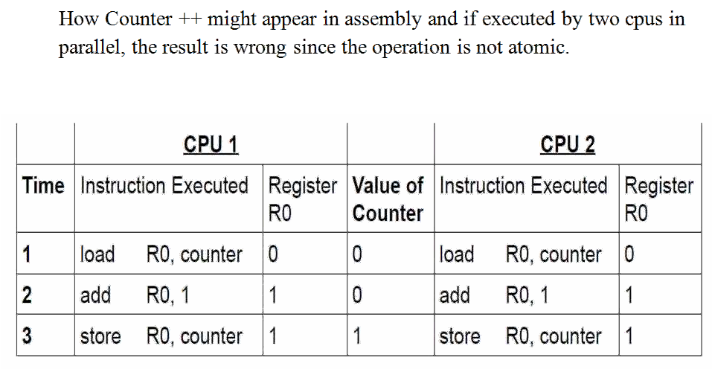

Slide 17
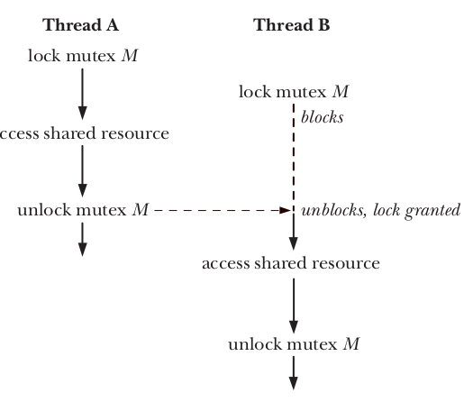
If multiple threads try to execute this block of code (a critical section), the fact that only one thread can hold the mutex (the others remain blocked) means that only one thread at a time can enter the block, as illustrated in Figure

Slide 18
Creating a Mutex
int pthread_mutex_init(pthread_mutex_t *mutex, const pthread_mutex_attr *attr);
The pthread_mutex_init() routine creates a new mutex, with attributes specified with attr, or default attributes if attr is NULL.
If the pthread_mutex_init() routine succeeds it will return 0 and put the new mutex ID into mutex, otherwise an error number shall be returned indicating the error.
Notes:
<number>

Slide 19
Destroying a Mutex
int pthread_mutex_destroy(pthread_mutex_t *mutex);
The pthread_mutex_destroy() routine destroys the mutex specified by mutex.
If the pthread_mutex_destroy() routine succeeds it will return 0, therwise an error number shall be returned indicating the error
Notes:
<number>

Slide 20
Locking Mutexes
int pthread_mutex_lock(pthread_mutex_t *mutex);
The pthread_mutex_lock() routine shall lock the mutex specified by mutex. If the mutex is already locked, the calling thread blocks until the mutex becomes available.
If the pthread_mutex_lock() routine succeeds it will return 0, otherwise an error number shall be returned indicating the error.
int pthread_mutex_trylock(pthread_mutex_t *mutex);
The pthread_mutex_trylock() routine shall lock the mutex specified by mutex and return 0, otherwise an error number shall be returned indicating the error.
In all cases the pthread_mutex_trylock() routine will not block the current running thread.
Notes:
<number>

Slide 21
Locking Mutexes
int pthread_mutex_timedlock(pthread_mutex_t *mutex,
struct timespec *restrict abs_timeout);
The pthread_mutex_timedlock() function shall lock the mutex object referenced by mutex. If the mutex is already locked, the calling thread shall block until the mutex becomes available as in the pthread_mutex_lock() function. If the mutex cannot be locked without waiting for another thread to unlock the mutex, this wait shall be terminated when the specified timeout expires.
Notes:
<number>

Slide 22
Unlocking Mutexes
int pthread_mutex_unlock(pthread_mutex_t *mutex);
If the current thread is the owner of the mutex specifed by mutex, then the pthread_mutex_unlock() routine shall unlock the mutex. If there are any threads blocked waiting for the mutex, the scheduler will determine which thread obtains the lock on the mutex, otherwise the mutex is available to the next thread that calls the routine pthread_mutex_lock(), or pthread_mutex_trylock().
If the pthread_mutex_unlock() routine succeeds it will return 0, otherwise an error number shall be returned indicating the error.
Notes:
<number>

Slide 23
Create and Destroy Thread Attributes
int pthread_attr_init(pthread_attr_t *attr);
pthread_attr_init() initializes the thread attribute object attr and
fills it with default values for the attributes.
int pthread_attr_destroy(pthread_attr_t *attr);
pthread_attr_destroy() destroys a thread attribute object, which
must not be reused until it is reinitialized.
Notes:
<number>

Slide 24
Mutex Deadlocks
Sometimes, a thread needs to simultaneously access two or more different shared
resources, each of which is governed by a separate mutex. When more than one
thread is locking the same set of mutexes, deadlock situations can arise.
shows an example of a deadlock in which each thread successfully locks one mutex,
and then tries to lock the mutex that the other thread has already locked. Both
threads will remain blocked indefinitely.
Thread A Thread B
1. pthread_mutex_lock(mutex1); 1. pthread_mutex_lock(mutex2);
2. pthread_mutex_lock(mutex2); 2. pthread_mutex_lock(mutex1);
blocks blocks
A deadlock when two threads lock two mutexes
The simplest way to avoid such deadlocks is to define a mutex hierarchy. When
threads can lock the same set of mutexes, they should always lock them in the same
order. For example, in the above scenario, the deadlock could be avoided if
the two threads always lock the mutexes in the order mutex1 followed by mutex2.

Slide 25
Thread condition variable
A mutex prevents multiple threads from accessing a shared variable at the same time. A condition variable allows one thread to inform other threads about changes in the state of a shared variable (or other shared resource) and allows the other threads to wait (block) for such notification.
Mutex it wastes CPU time, because the main thread continually loops, checking the state of the variable avail. A condition variable remedies this problem. It allows a thread to sleep (wait) until another thread notifies (signals) it that it must do something (i.e., that some “condition” has arisen that the sleeper must now respond to).
A condition variable is always used in conjunction with a mutex. The mutex provides mutual exclusion for accessing the shared variable, while the condition variable is used to signal changes in the variable’s state.

Slide 26
Thread safety
#define _GNU_SOURCE
#include <stdio.h>
#include <string.h>
/* Get '_sys_nerr' and '_sys_errlist'
declarations from <stdio.h> */
/* Get declaration of strerror() */
#define MAX_ERROR_LEN 256 /* Maximum length of string
returned by strerror() */
static char buf[MAX_ERROR_LEN]; /* Statically allocated return buffer */
char *
strerror(int err)
{
if (err < 0 || err >= _sys_nerr || _sys_errlist[err] == NULL) {
snprintf(buf, MAX_ERROR_LEN, "Unknown error %d", err);
} else {
strncpy(buf, _sys_errlist[err], MAX_ERROR_LEN - 1);
buf[MAX_ERROR_LEN - 1] = '\0';
/* Ensure null termination */
}
return buf;
}
Gdb> Info threads
Gdb> thread id
Gdb> thread apply all backtrace/f

Slide 27
Signals and Threads
Signal actions are process-wide. If any unhandled signal whose default action is stop or terminate is delivered to any thread in a process, then all of the threads in the process are stopped or terminated. Signal handlers are per process, signal masks are per thread. On a multithreaded application the signal handler execute in one of the thread contexts. We cant predict the thread that will be chosen to run the signal handler. All the signals fields are stored per thread. Actually , there is no structure for the process , all the threads on the same process points to the same memory and files tables so the kernel need to choose a thread to deliver the signal to:
pthread_kill() to send a signal directly to a thread.
int pthread_kill(pthread_t thread, int sig);
However, one process attribute, the nice value, allows a process to indirectly influence the kernel’s scheduling algorithm. Each process has a nice value in the range –20 (high priority) to +19 (low priority); the default is 0
- We can avoid the performance impacts caused by invalidation of cached data. If multiple threads (or processes) are accessing the same data, then we may obtainperformance benefits by confining them all to the same CPU, so that they don’t contend for the data and thus cause cache misses.
- For a time-critical application, it may be desirable to confine most processes on the system to other CPUs, while reserving one or more CPUs for the time-critical application

